Slide 1
Capstone Project
Hotel Booking Analysis
Koushik Das
M Anirudh Goud
Rupini Gandhaveeti
Chand Kamble

Slide 2
Points to Discuss:
Agenda
Data summary
Univariate analysis
Hotel wise analysis
Distribution Channel wise analysis
Timewise analysis
Correlation heatmap
Conclusion

Slide 3
Agenda
To discuss the analysis of given hotel bookings data set from 2015-2017.
We’ll be doing analysis of given data set in following ways :
Univariate analysis
Hotel wise analysis
Distribution Channel wise analysis
Timewise analysis
By doing this we’ll try to find out key factors driving the hotel bookings trends.

Slide 4
Data Summary
Given data set has different columns of variables crucial for hotel bookings. Some of them are:
hotel: The category of hotels, which are two resort hotel and city hotel.
is_cancelled : The value of column show the cancellation type. If the booking was cancelled or not.
Values[0,1], where 0 indicates not cancelled.
lead_time : The time between reservation and actual arrival.
stayed_in_weekend_nights: The number of weekend nights stay per reservation
stayed_in_weekday_nights: The number of weekday nights stay per reservation. meal: Meal preferences per reservation.[BB,FB,HB,SC,Undefined]
Country: The origin country of guest.

Slide 5
Data Summary(contd..)
market_segment: This column show how reservation was made and what is the purpose
of reservation. Eg, corporate means corporate trip, TA for travel agency.
distribution_channel: The medium through booking was made.[Direct,Corporate,TA/TO,undefined,GDS.]
Is_repeated_guest: Shows if the guest is who has arrived earlier or not.Values[0,1]-->0
indicates no and 1 indicated yes person is repeated guest.
days_in_waiting_list: Number of days between actual booking and transact.
customer_type: Type of customers( Transient, group, etc.)

Slide 6
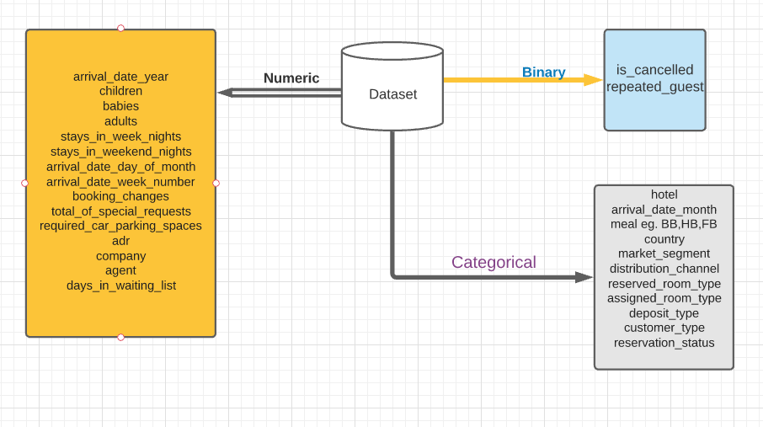
Data Summary

Slide 7
Univariate Analysis
EDA
Exploratory data analysis is used by data scientists to analyze and investigate data sets and summarize their main characteristics, often employing data visualization methods.
EDA is primarily used to see what data can reveal beyond the formal modeling or hypothesis testing task and provides a better understanding of data set variables and the relationships between them.
In this project we will try to give answer of some real life problems by analyzing and visualization the given dataset.

Slide 8
Hotel wise Analysis
While doing hotel-wise analysis of given hotel booking dataset, we answered following questions:
Percentage of bookings in each hotels?
Which hotel makes more revenue?
For which hotel, does people have to wait longer to get a booking confirmed?
Which hotel has higher booking cancellations rate?

Slide 9
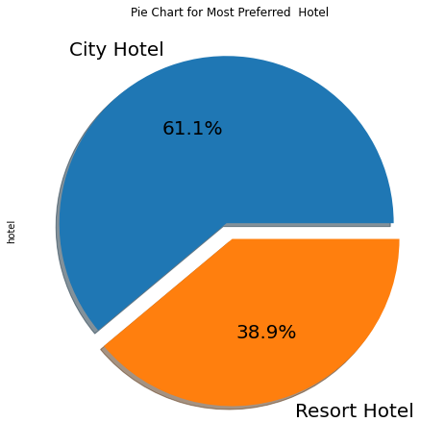
Which type of hotel is mostly preferred?
Around 60% bookings are for City hotel and 40% bookings are for Resort hotel.
We can see that City Hotels are more preferred.

Slide 10
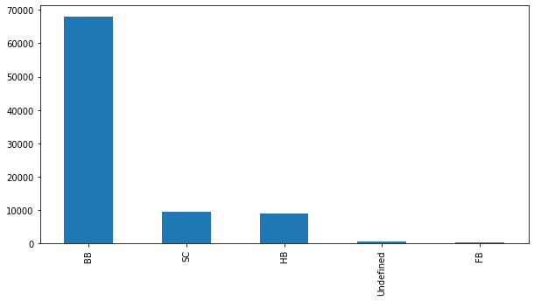
Which type of meal is mostly preferred?
Types of meal in the hotels:
BB - (Bed and Breakfast)
HB- (Half Board)
FB- (Full Board)
SC- (Self Catering)
So the most preferred meal type by the guests is BB( Bed and Breakfast).

Slide 11
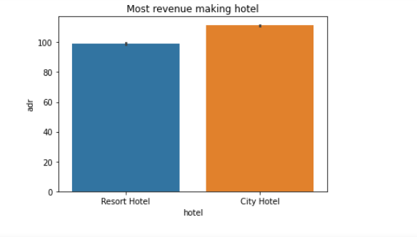
Which types of hotel makes more revenue?
We can see City Hotel makes more revenue as compare to Resort Hotel.

Slide 12
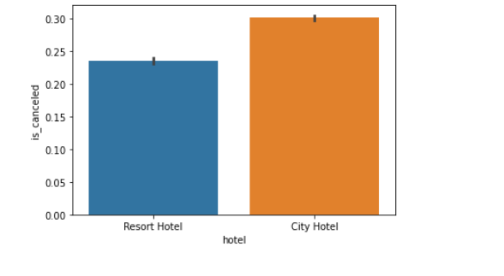
Which types of hotel has higher booking cancelation rate?
So, City Hotel has the higher cancelation rate.
Almost 30 % of City Hotel bookings and 25 % of Resort hotel bookings got canceled.

Slide 13
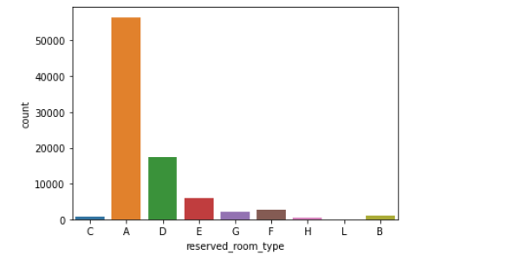
Which types of rooms are most reserved?
We can see ‘A’ type of rooms are most reserved.

Slide 14
Distribution channel wise Analysis
While doing Distribution channel wise analysis of given hotel booking dataset, we answered
following questions:
Which is the most common channel for booking hotels?
Which type of market segment is mostly preferred by peoples?
Most no of days in waiting list for different market segments.

Slide 15
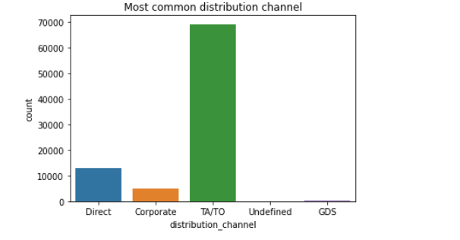
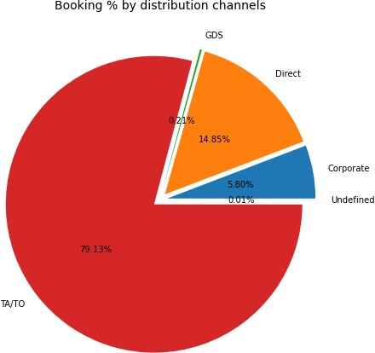
Which is the most common channel for booking hotels?
We see that TA/TO is the most common distribution channel.
Than the second most used channel is direct.

Slide 16
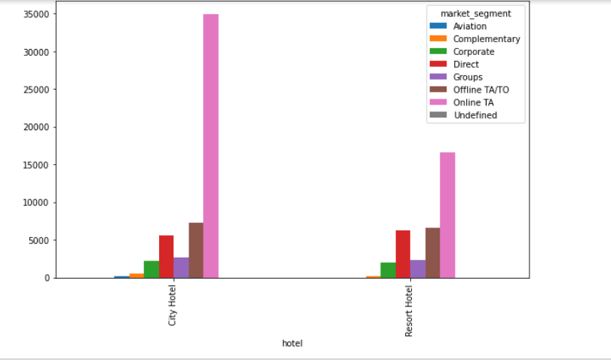
Market segment VS Hotel
In each types of hotels, peoples preferred online TA.

Slide 17
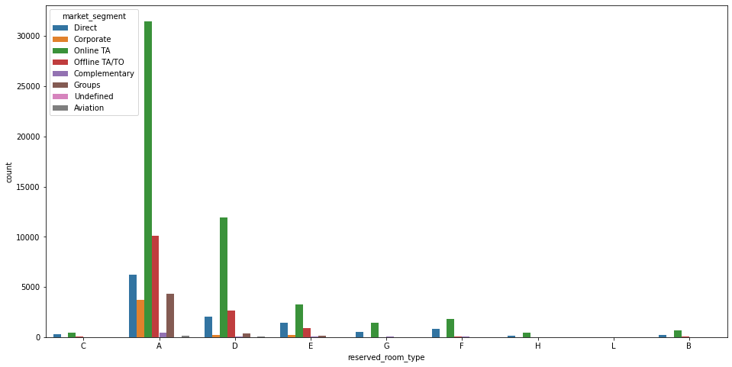
Market segment VS preferred room types
Majority of peoples reserved rooms via online TA from different market segments.
Also we can see majority of the people preferred room type A.

Slide 18
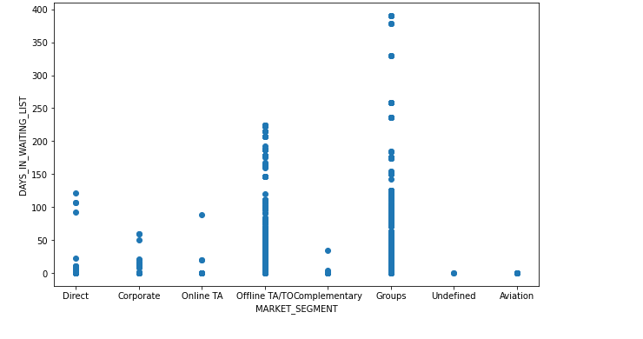
Most no of days in waiting list for different market segments.
Most no of days in waiting list are for the Groups market segments.

Slide 19
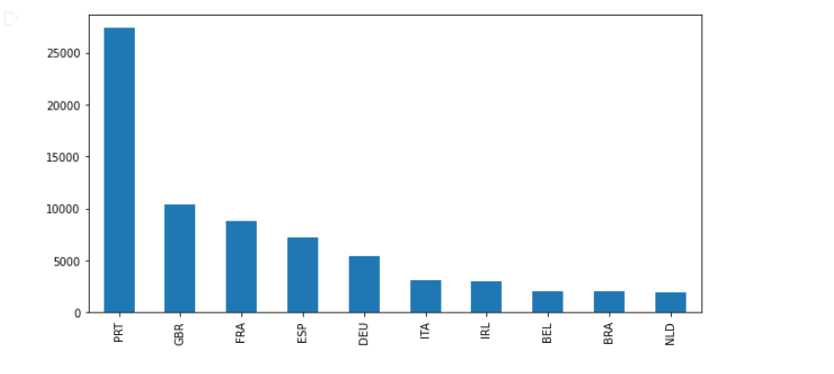
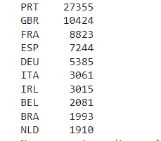
From which country most of the peoples are coming in the hotel ?
We see that most of the guests are come from Portugal, Great Britain, France and Spain.

Slide 20
Time-wise Analysis
While doing time-wise analysis of given hotel booking dataset, we answered following questions:
What are the most busy months for hotels?
How does bookings varies along with the year?
In which month most number of peoples arrive?

Slide 21
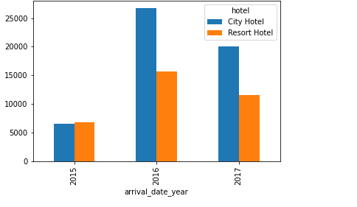
2016 had the highest booking.
2015 had lowest bookings.
overall City hotels had the most of the bookings.

Slide 22
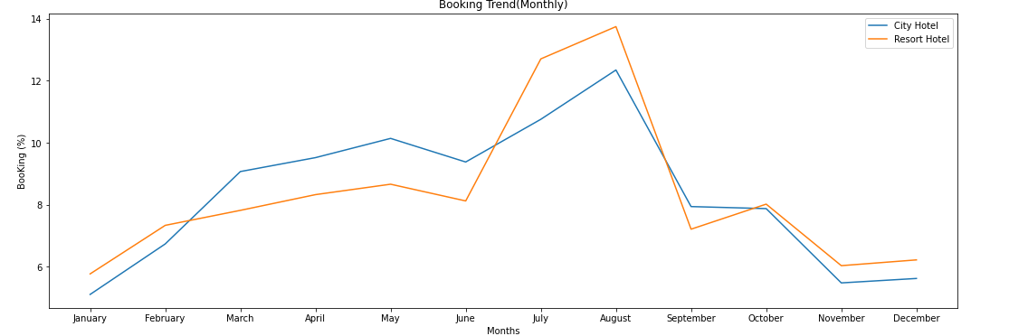
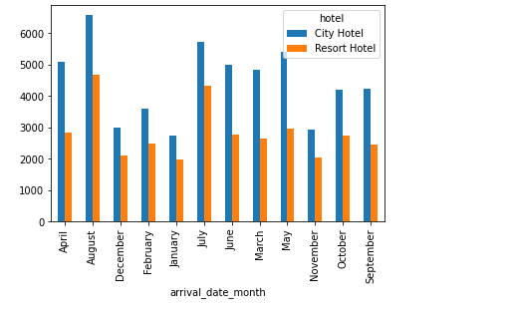
July and August months had the most Bookings.

Slide 23
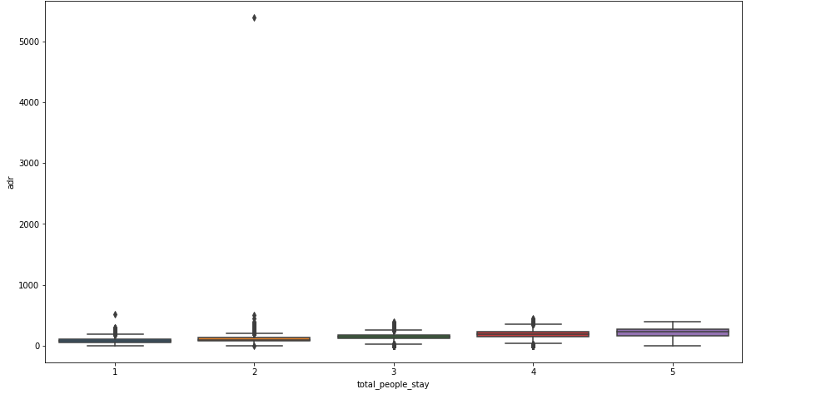
From the Box plot we can observe that as the total number of people increases adr also increases.

Slide 24
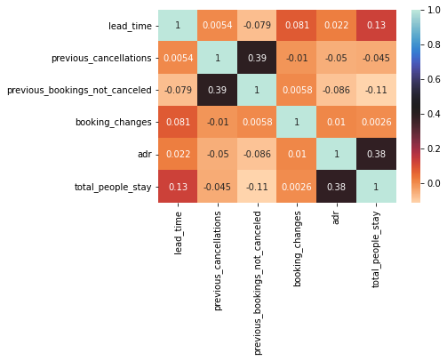
Correlation Heatmap
Total no of peoples stay in the hotel and lead time have slightly positive correlation.
.
adr is slightly correlated with total_no of
People stay in the hotel, which makes sense as more no of people means more revenue, therefore more adr.

Slide 25
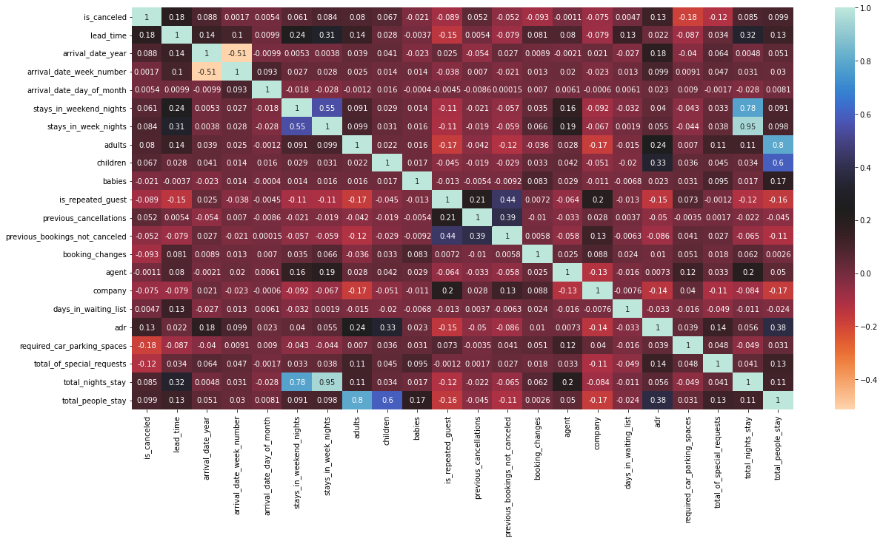

Slide 26
Conclusion
Around 60% bookings are for City hotel and 40% bookings are for Resort hotel, therefore City Hotel is busier
than Resort hotel. Also the overall adr of City hotel is slightly higher than Resort hotel.
BB types meal is most preferred by the guest.
City hotels have significantly higher booking cancellation rates
Most of the guests came from european countries, with most no. of guest coming from Portugal.
Guests use different channels for making bookings out of which most preferred way is TA/TO.
July- August are the most busier and profitable months for both of hotels.
2016 had the highest bookings.
adr and the total number of peoples are positively correlated.

Slide 27
Thank You

